Slide 1

AIRBNB Hotel Booking Analysis
Yogant Chandrakant Patil
[AICTE Internship ID:INTERNSHIP_17546440516895be537820f ]

Slide 2

PROBLEM STATEMENT
Airbnb is a leading platform that allows property owners to offer their homes or apartments to travelers. A key challenge for hosts lies in setting the right price for their listings, as pricing is influenced by multiple factors including the number of bedrooms and bathrooms, cleanliness standards, accuracy of property descriptions, and the quality of communication with guests.

Slide 3
Project Description This project is centered on creating a machine learning model to estimate the price of Airbnb listings. Accurate pricing plays a vital role for both hosts and guests: hosts aim to boost occupancy and revenue, while guests look for reasonable and competitive rates. By analyzing historical Airbnb data, the project applies regression techniques to uncover how different listing featuressuch as the number of bedrooms, bathrooms, and guest reviews affect the final price.

Slide 4

WHO ARE THE END USERS?
Airbnb Hosts
Can use the model to set competitive prices for their properties by considering features and guest feedback.
Travelers
Can assess whether a listing offers fair value for the price charged.
Airbnb Platform Analysts
Can enhance dynamic pricing tools and strengthen user confidence in the platform.
Researchers/Students
Can explore how property characteristics and reviews influence rental pricing trends.

Slide 5

Technology Used
Python - Primary programming language for implementation.
Pandas & NumPy – For handling, cleaning, and preprocessing data.
Scikit-learn – For building, training, and evaluating regression models.
Matplotlib/Seaborn- For data visualization and analyzing feature importance.
Google Colab – Cloud-based environment to develop and run the project.
File handling libraries - openpyxl for working with Excel files and Python’s built-in CSV utilities for dataset management.

Slide 6
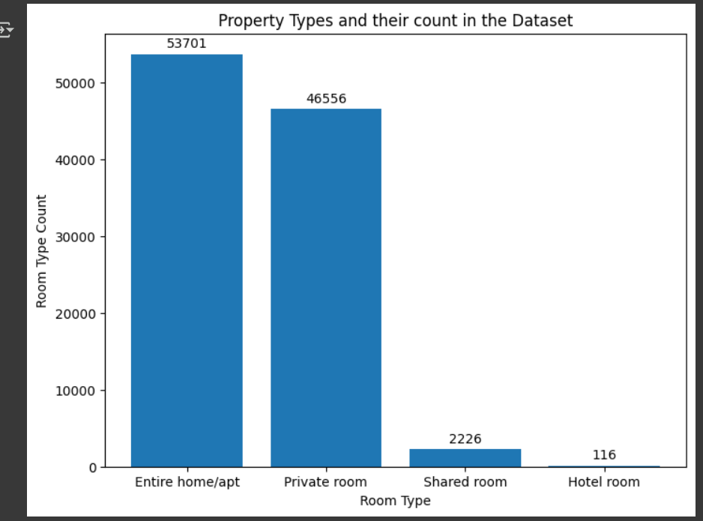
RESULTS1

Slide 7
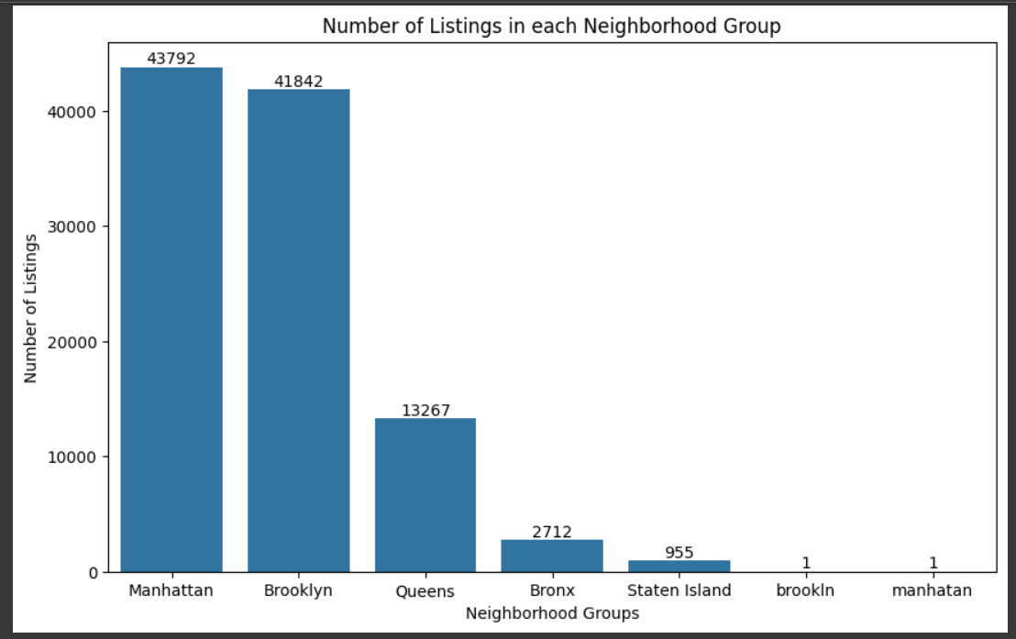
RESULTS2
[Add screen shots of your code or Chart(s) ]
Code Link

Slide 8
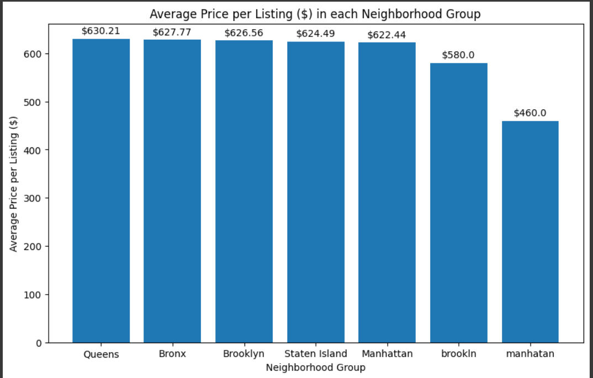
RESULTS3
[Add screen shots of your code or Chart(s) ]
Code Link

Slide 9
GitHub repository
https://github.com/yogant18/VOIS_AICTE_Oct2025_YogantPatil
Github Link

Slide 10
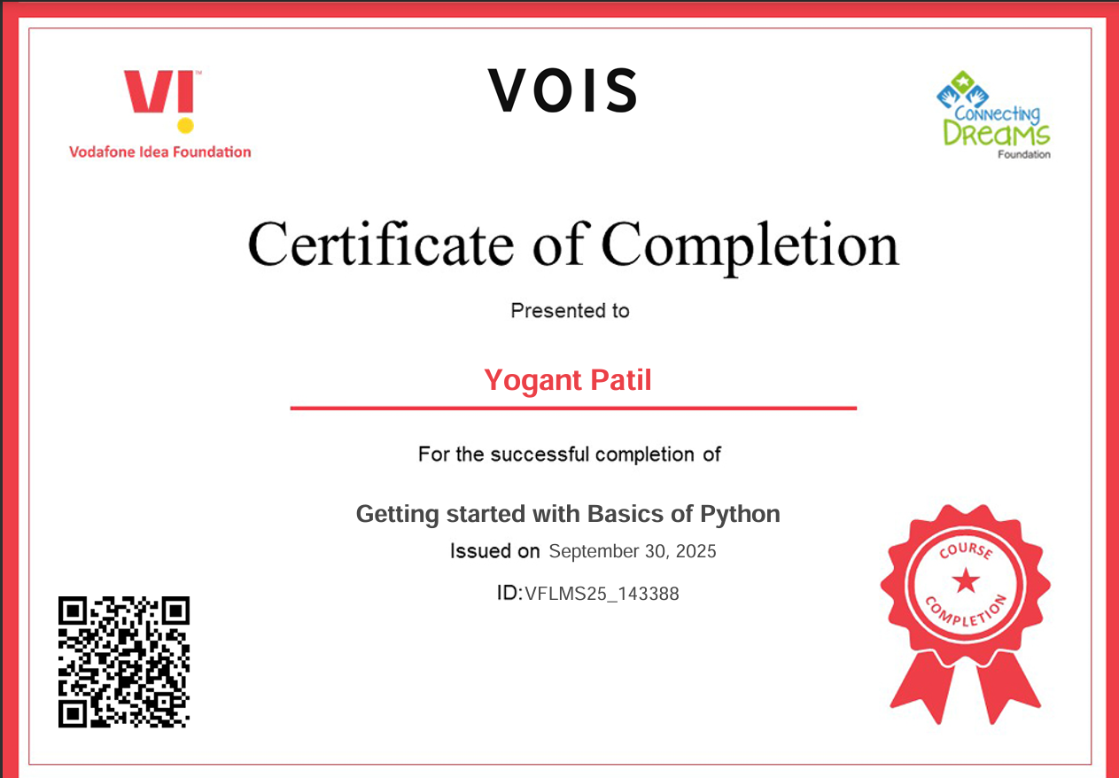
Getting started with Basics of Python Certificate
[Paste your Certificate Here]

Slide 11
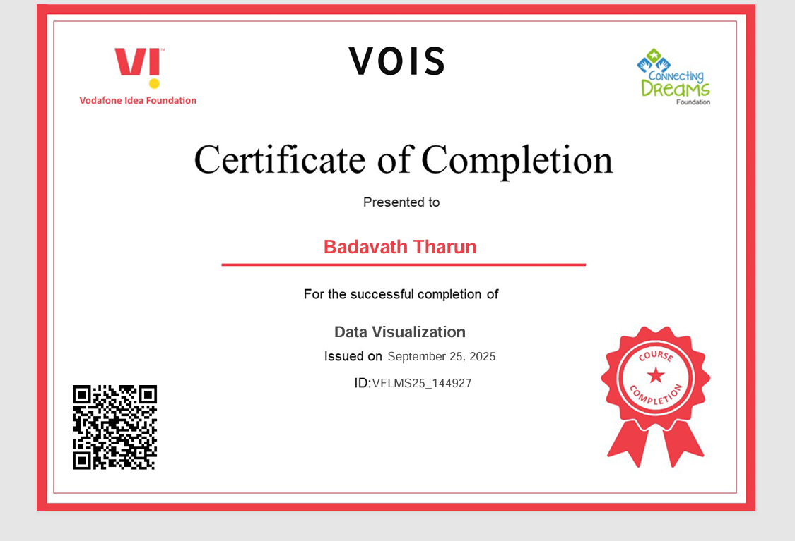
Data Visualization Certificate
[Paste your Certificate Here]

Slide 12
Thank you
.
.

